Slide 1

Rajeev Gupta rgupta.mtech@gmail.com Java Trainer & Consultant

Slide 2
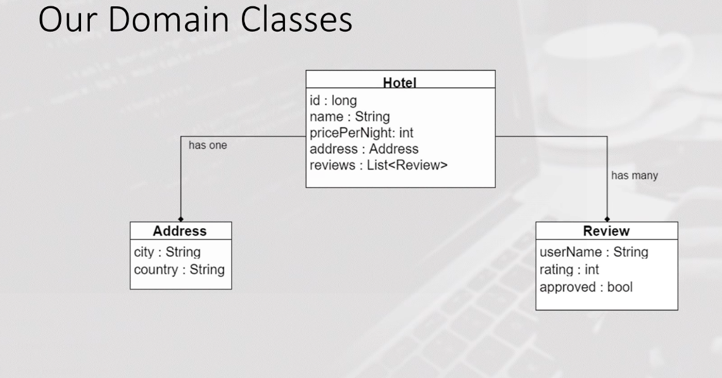
Spring data mongodb example app

Slide 3
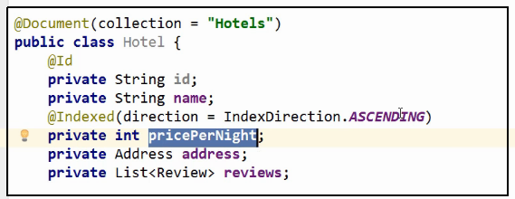
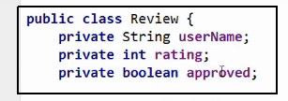


Spring data mongodb example app

Slide 4
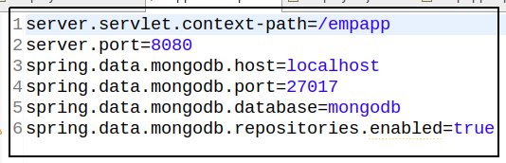
Spring data mongodb example app

